Slide 1
Discrete Mathematics Lecture 3
Liangfeng Zhang
School of Information Science and Technology
ShanghaiTech University

Slide 2
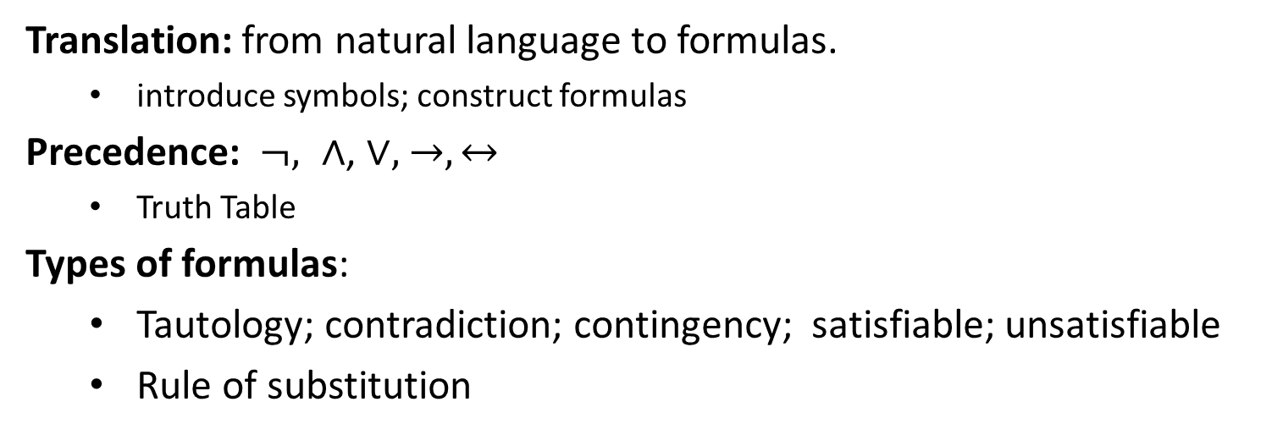
Summary of Lecture 2
Translation: from natural language to formulas.
introduce symbols; construct formulas
Precedence: $¬, ∧$, $∨,$ $→, ↔$
Truth Table
Types of formulas:
Tautology; contradiction; contingency; satisfiable; unsatisfiable
Rule of substitution

Slide 3
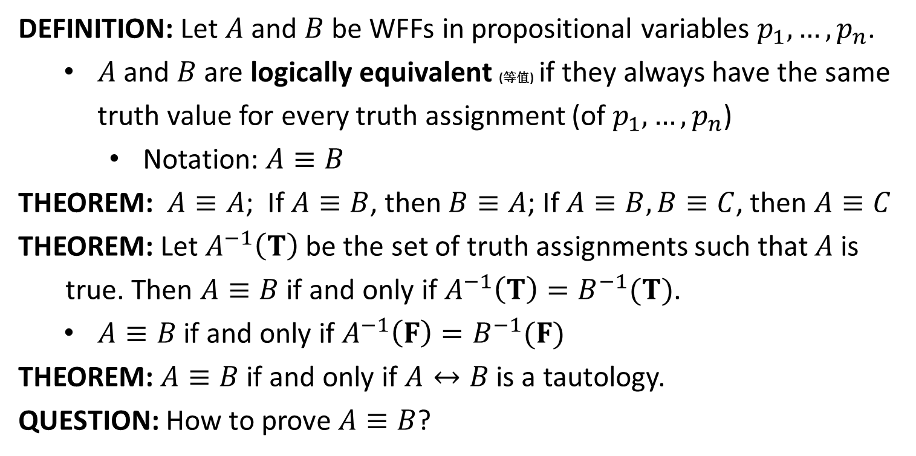
Logically Equivalent
DEFINITION: Let $A$ and $B$ be WFFs in propositional variables $p_{1},…,p_{n}$.
$A$ and $B$ are logically equivalent (等值) if they always have the same truth value for every truth assignment (of $p_{1},…,p_{n}$)
Notation: $A≡B$
THEOREM: $A≡A$; If $A≡B$, then $B≡A$; If $A≡B, B≡C$, then $A≡C$
THEOREM: Let $A^{−1}\left(T\right)$ be the set of truth assignments such that $A$ is
true. Then $A≡B$ if and only if $A^{−1}\left(T\right)=B^{−1}(T)$.
$A≡B$ if and only if $A^{−1}\left(F\right)=B^{−1}(F)$
THEOREM: $A≡B$ if and only if $A↔B$ is a tautology.
QUESTION: How to prove $A≡B$?

Slide 4
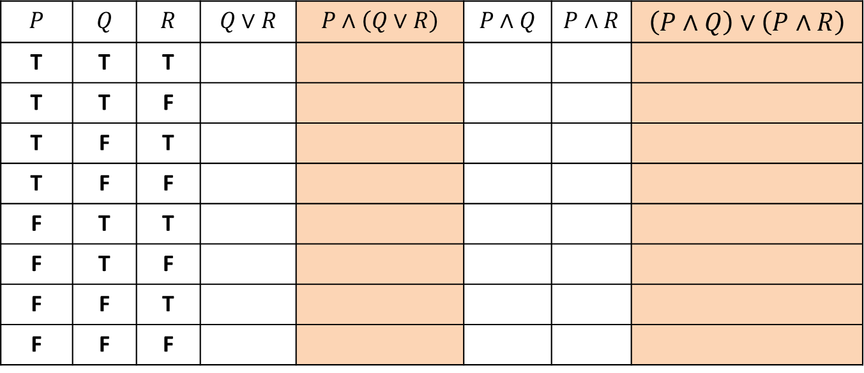
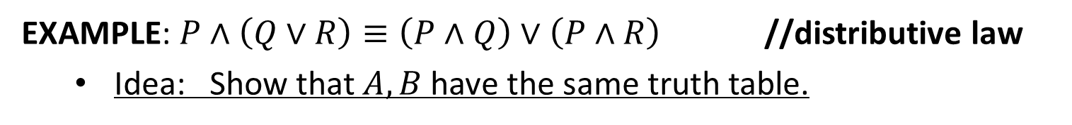

Proving $A≡B$
EXAMPLE: $P∧\left(Q∨R\right)≡\left(P∧Q\right)∨\left(P∧R\right)$ //distributive law
Idea: Show that $A, B$have the same truth table.
$$P$$ | $$Q$$ | $$R$$ | $$Q∨R$$ | $$P∧\left(Q∨R\right)$$ | $$P∧Q$$ | $$P∧R$$ | $$\left(P∧Q\right)∨\left(P∧R\right)$$
T | T | T
T | T | F
T | F | T
T | F | F
F | T | T
F | T | F
F | F | T
F | F | F

Slide 5
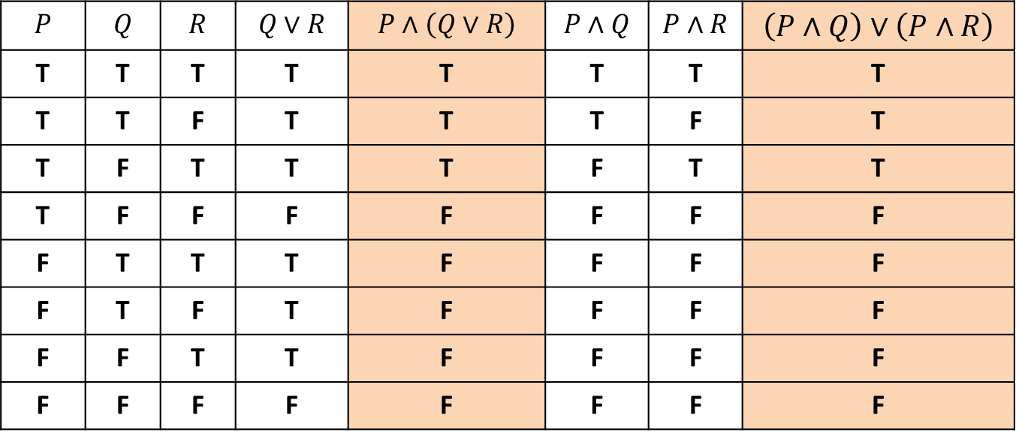
Proving $A≡B$
EXAMPLE: $P∧\left(Q∨R\right)≡\left(P∧Q\right)∨\left(P∧R\right)$ //distributive law
Idea: Show that $A, B$have the same truth table.
$$P$$ | $$Q$$ | $$R$$ | $$Q∨R$$ | $$P∧\left(Q∨R\right)$$ | $$P∧Q$$ | $$P∧R$$ | $$\left(P∧Q\right)∨\left(P∧R\right)$$
T | T | T | T | T | T | T | T
T | T | F | T | T | T | F | T
T | F | T | T | T | F | T | T
T | F | F | F | F | F | F | F
F | T | T | T | F | F | F | F
F | T | F | T | F | F | F | F
F | F | T | T | F | F | F | F
F | F | F | F | F | F | F | F
REMARK: $P∨\left(Q∧R\right)≡\left(P∨Q\right)∧\left(P∨R\right)$ can be shown similarly.

Slide 6

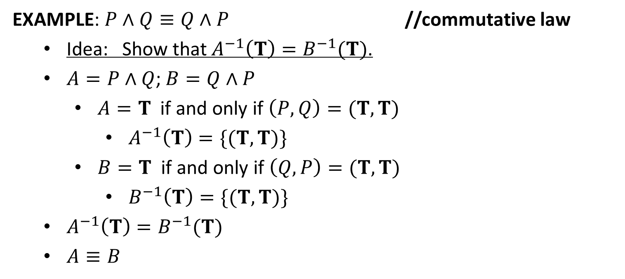
Proving $A≡B$
EXAMPLE: $P∧Q≡Q∧P$ //commutative law
Idea: Show that $A^{−1}\left(T\right)=B^{−1}(T)$.
$A=P∧Q$; $B=Q∧P$
$A=T$ if and only if $\left(P,Q\right)=(T,T)$
$A^{−1}\left(T\right)=\{(T,T)\}$
$B=T$ if and only if $\left(Q,P\right)=(T,T)$
$B^{−1}\left(T\right)=\{(T,T)\}$
$A^{−1}\left(T\right)=B^{−1}(T)$
$A≡B$
REMARK: $P∧\left(Q∧R\right)≡\left(P∧Q\right)∧R$ can be shown similarly.
Associative law

Slide 7

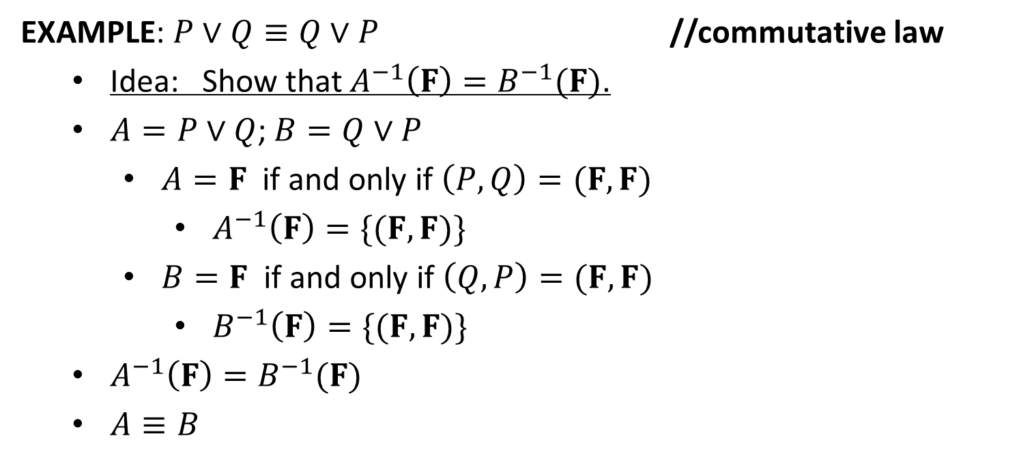
Proving $A≡B$
EXAMPLE: $P∨Q≡Q∨P$ //commutative law
Idea: Show that $A^{−1}\left(F\right)=B^{−1}(F)$.
$A=P∨Q$; $B=Q∨P$
$A=F$ if and only if $\left(P,Q\right)=(F,F)$
$A^{−1}\left(F\right)=\{(F,F)\}$
$B=F$ if and only if $\left(Q,P\right)=(F,F)$
$B^{−1}\left(F\right)=\{(F,F)\}$
$A^{−1}\left(F\right)=B^{−1}(F)$
$A≡B$
REMARK: $P∨\left(Q∨R\right)≡\left(P∨Q\right)∨R$ can be shown similarly.
Associative law

Slide 8
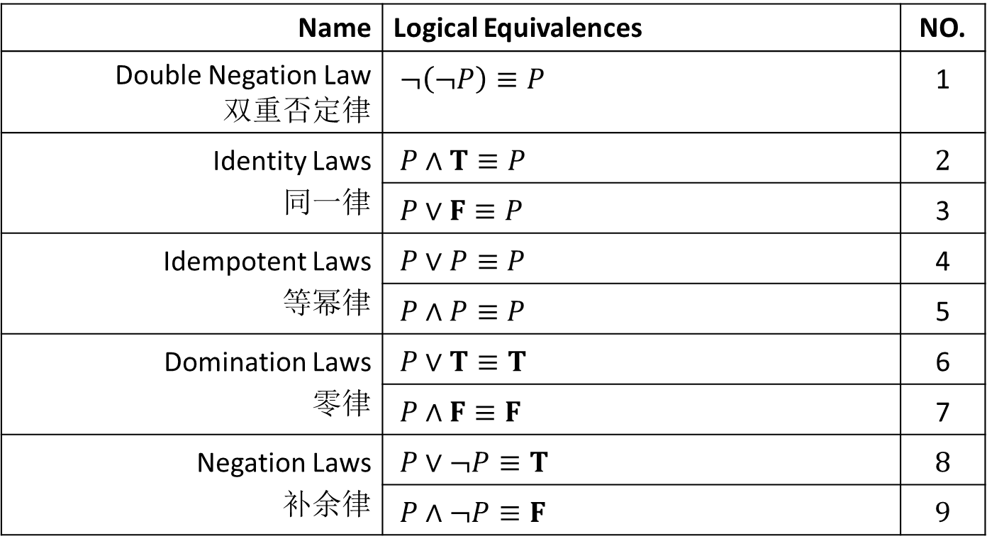
Logical Equivalences
Name | Logical Equivalences | NO.
Double Negation Law 双重否定律 | $¬\left(¬P\right)≡P$ | 1
Identity Laws 同一律 | $P∧T≡P$ | 2
 | $P∨F≡P$ | 3
Idempotent Laws 等幂律 | $P∨P≡P$ | 4
 | $P∧P≡P$ | 5
Domination Laws 零律 | $P∨T≡T$ | 6
 | $P∧F≡F$ | 7
Negation Laws 补余律 | $P∨¬P≡T$ | 8
 | $P∧¬P≡F$ | 9

Slide 9
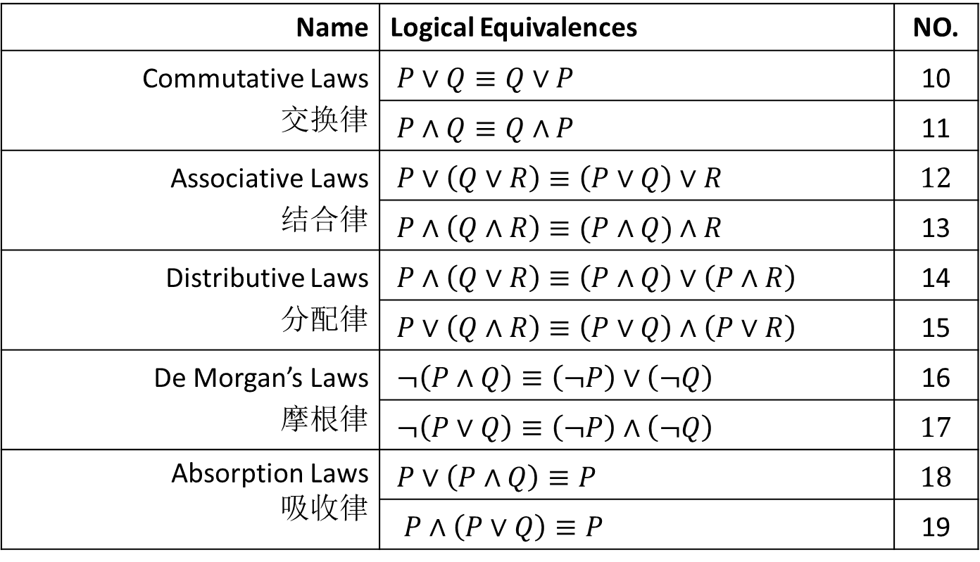
Logical Equivalences
Name | Logical Equivalences | NO.
Commutative Laws 交换律 | $P∨Q≡Q∨P$ | 10
 | $P∧Q≡Q∧P$ | 11
Associative Laws 结合律 | $P∨\left(Q∨R\right)≡\left(P∨Q\right)∨R$ | 12
 | $P∧\left(Q∧R\right)≡(P∧Q)∧R$ | 13
Distributive Laws 分配律 | $P∧\left(Q∨R\right)≡\left(P∧Q\right)∨\left(P∧R\right)$ | 14
 | $P∨\left(Q∧R\right)≡\left(P∨Q\right)∧\left(P∨R\right)$ | 15
De Morgan’s Laws 摩根律 | $¬\left(P∧Q\right)≡\left(¬P\right)∨\left(¬Q\right)$ | 16
 | $¬\left(P∨Q\right)≡\left(¬P\right)∧\left(¬Q\right)$ | 17
Absorption Laws 吸收律 | $P∨\left(P∧Q\right)≡P$ | 18
 | $P∧\left(P∨Q\right)≡P$ | 19

Slide 10
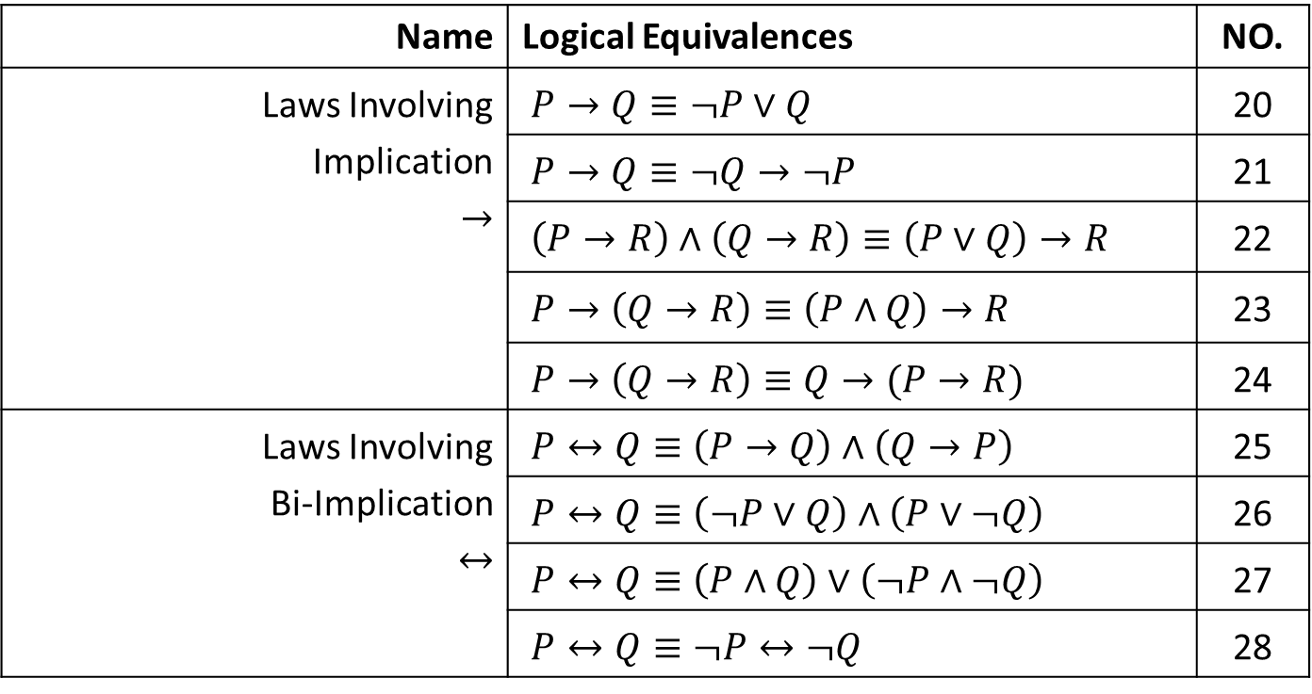
Logical Equivalences
Name | Logical Equivalences | NO.
Laws Involving Implication $→$ | $P→Q≡¬P∨Q$ | 20
 | $P→Q≡¬Q→¬P$ | 21
 | $\left(P→R\right)∧\left(Q→R\right)≡\left(P∨Q\right)→R$ | 22
 | $P→\left(Q→R\right)≡\left(P∧Q\right)→R$ | 23
 | $P→\left(Q→R\right)≡Q→(P→R)$ | 24
Laws Involving Bi-Implication $↔$ | $P↔Q≡\left(P→Q\right)∧\left(Q→P\right)$ | 25
 | $P↔Q≡\left(¬P∨Q\right)∧\left(P∨¬Q\right)$ | 26
 | $P↔Q≡\left(P∧Q\right)∨\left(¬P∧¬Q\right)$ | 27
 | $P↔Q≡¬P↔¬Q$ | 28

Slide 11



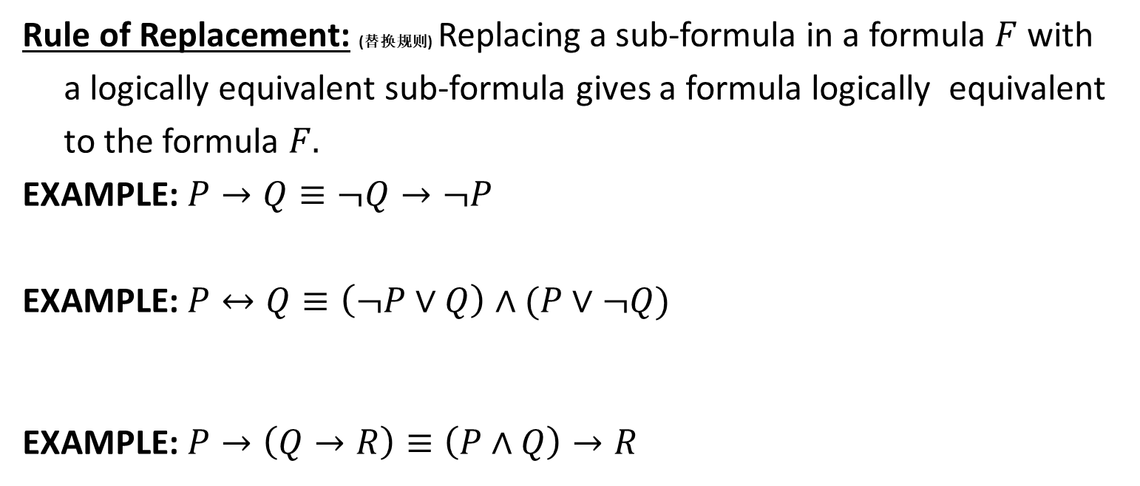












Proving $A≡B$
Rule of Replacement: (替换规则) Replacing a sub-formula in a formula $F$ with
a logically equivalent sub-formula gives a formula logically equivalent
to the formula $F.$
EXAMPLE: $P→Q≡¬Q→¬P$
EXAMPLE: $P↔Q≡\left(¬P∨Q\right)∧(P∨¬Q)$
EXAMPLE: $P→\left(Q→R\right)≡\left(P∧Q\right)→R$
$$P→Q$$
$$≡¬P∨Q$$
$$≡Q∨¬P$$
$$≡¬\left(¬Q\right)∨¬P$$
$$≡¬Q→¬P$$
$$P↔Q$$
$$≡\left(P→Q\right)∧(Q→P)$$
$$≡\left(¬P∨Q\right)∧(¬Q∨P)$$
$$≡\left(¬P∨Q\right)∧(P∨¬Q)$$
$$P→\left(Q→R\right)$$
$$≡¬P∨(¬Q∨R)$$
$$≡\left(¬P∨¬Q\right)∨R$$
$$≡¬\left(P∧Q\right)∨R$$
$$≡\left(P∧Q\right)→R$$

Slide 12
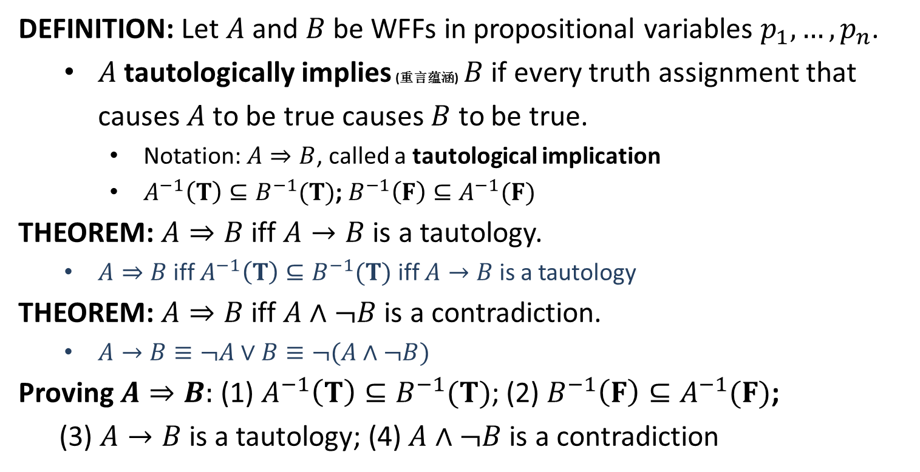
Tautological Implications
DEFINITION: Let $A$ and $B$ be WFFs in propositional variables $p_{1},…,p_{n}$.
$A$ tautologically implies (重言蕴涵) $B$ if every truth assignment that causes $A$ to be true causes $B$ to be true.
Notation: $A⇒B$, called a tautological implication
$A^{−1}\left(T\right)⊆B^{−1}(T)$; $B^{−1}\left(F\right)⊆A^{−1}(F)$
THEOREM: $A⇒B$ iff $A→B$ is a tautology.
$A⇒B$ iff $A^{−1}\left(T\right)⊆B^{−1}(T)$ iff $A→B$ is a tautology
THEOREM: $A⇒B$ iff $A∧¬B$ is a contradiction.
$A→B≡¬A∨B≡¬(A∧¬B)$
Proving $A⇒B:$ (1) $A^{−1}\left(T\right)⊆B^{−1}(T)$; (2) $B^{−1}\left(F\right)⊆A^{−1}(F)$;
(3) $A→B$ is a tautology; (4) $A∧¬B$ is a contradiction

Slide 13
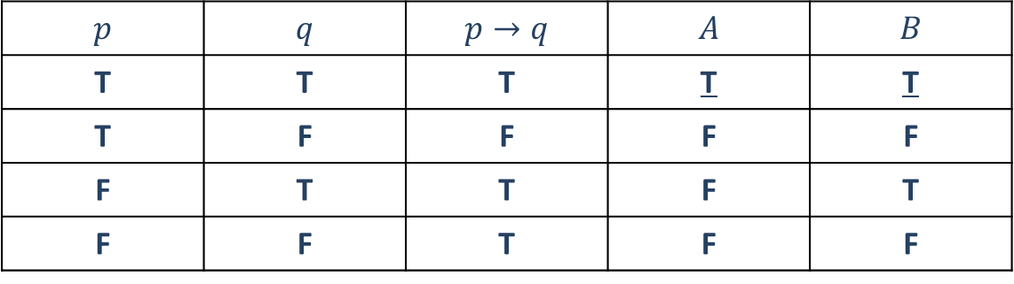


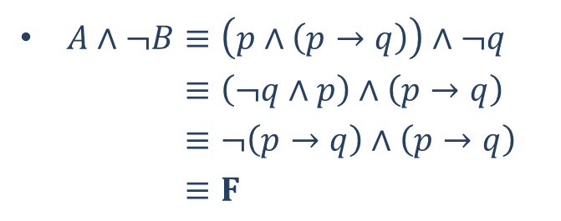
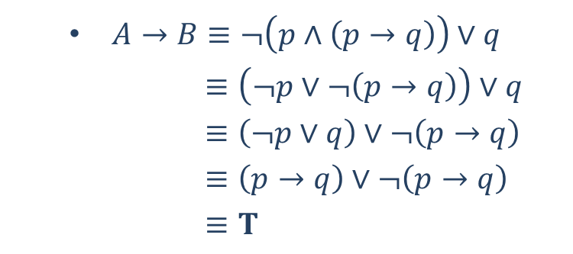
Proving $A⇒B$
EXAMPLE: Show the tautological implication “$p∧(p→q)⇒q$”.
Let $A=p∧\left(p→q\right);B=q$. Need to show that “$A⇒B$”
$A^{−1}\left(T\right)=\left\{\left(T,T\right)\right\};B^{−1}\left(T\right)=\{\left(T,T\right),(F,T)\}$: $A^{−1}\left(T\right)⊆B^{−1}(T)$.
$$p$$ | $$q$$ | $$p→q$$ | $$A$$ | $$B$$
T | T | T | T | T
T | F | F | F | F
F | T | T | F | T
F | F | T | F | F
$A→B≡¬\left(p∧\left(p→q\right)\right)∨q$
$≡\left(¬p∨¬\left(p→q\right)\right)∨q$
$≡\left(¬p∨q\right)∨¬\left(p→q\right)$
$≡\left(p→q\right)∨¬\left(p→q\right)$
$≡T$
$A∧¬B≡\left(p∧\left(p→q\right)\right)∧¬q$
$≡\left(¬q∧p\right)∧\left(p→q\right)$
$≡¬\left(p→q\right)∧\left(p→q\right)$
$≡F$

